Slide 1
Data To Text Generation using LM
Sumit Jain, 190050119
Akshay Iyer, 190070006
Adit Akarsh, 19D070003
Prateek Neema, 20D070061 10/03/2023

Slide 2
Problem Statement
We wish to detect and control hallucinations in natural language generation, when using data from a certain data source. This is very important today, since models like ChatGPT are being used extensively, yet are not very reliable for accurate information.
We are focusing on fine-tuning the LM to generate textual information from tabular data.

Slide 3
Related works
Mention some of the recent published/arxiv works related to your problem statement
Controlling Hallucinations at Word Level in Data-to-Text Generation
Survey of Hallucination in Natural Language Generation
Detecting Hallucinated Content in Conditional Neural Sequence Generation

Slide 4
Dataset (s)
WikiBio - 728, 321 tables
paired with the first sentence of the corresponding Wikipedia English article
Average length - 26 words
12 key-value pairs on average
ToTTo - 120,761 training examples
7700 validation and test examples
Pairing up summary and candidate sentence through similarity in Wikipedia page

Slide 5
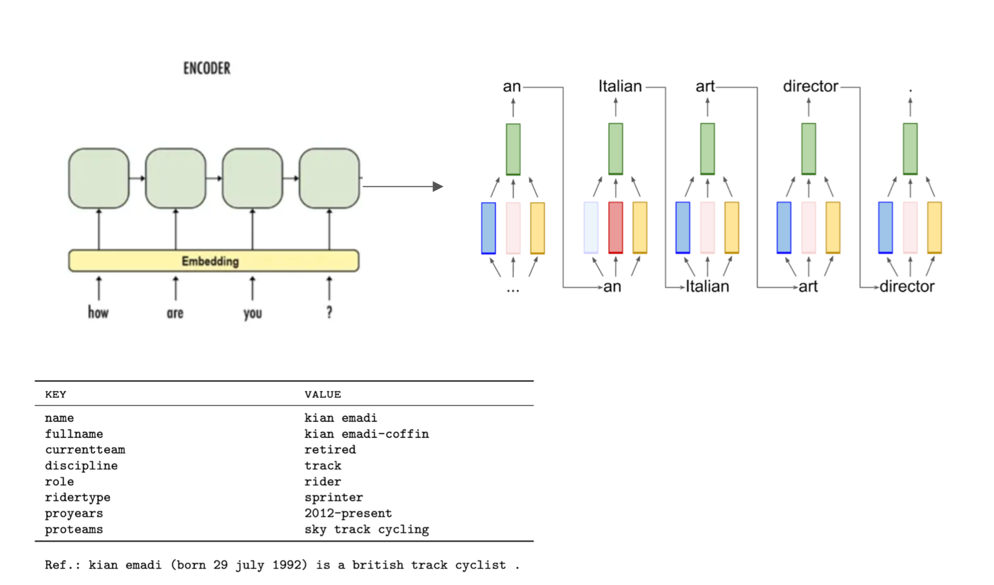
Architecture Plan
Current model is an encoder decoder with attention.
Three different decoder RNNs that have a weighted sum to give the net decoder state.
Three weights for content, hallucination and fluency.
Dynamic weight assignment for the three decoder RNNs during training. Manual, controllable and fixed weights during inference.
More manual hallucination, less content implies more emphasis on diversity than accuracy.

Slide 6
Experimental Setup
Generation:
Encoder: Convolutional Features
Decoder: Feature Vectors

Slide 7
Metrics to be used
BLEU for n = 1,2,3,4 - Bilingual Evaluation Understudy. It lies between [0,1]. Higher the score better the quality of caption
PARENT precision, recall and f-measure (Smoothed n-gram for DTG tasks, over both reference and input table)
Hallucination rate (as a percentage). From the deterministic rule we defined earlier.
Mean sentence length
Flesch readability index

